Slide 1

Department of Information Technology
Session 2024-25
Mini Project PQAI on
Epilepsy Prediction and Emergency Response System
Presented By Group No: 12
Mr.Bhagyesh Nand (Roll no:144)
Mr.Kartik Nagrale (Roll no:154)
Mr.Sumedh Bhaget (Roll no:167)
Mr.Ashutosh Dekate (Roll no:141)
Guided By
Dr.Nisha Wankhede
1
Notes:
1

Slide 2
Contents
Abstract
Introduction
Problem Definition
Aim & Objectives
Literature Review
Patent Search
Research Gap
Hardware Software Requirement
Proposed methodology
Experimental Results
Plan of Action
Conclusion and Future Scope
References

Slide 3
Abstract
Epilepsy, a neurological disorder characterized by recurrent seizures, poses significant challenges in both diagnosis and management.
The project introduces a novel machine designed to detect epileptic seizures and administer emergency medication autonomously.
The system uses real-time monitoring of physiological signals, such as brain activity and heart rate, combined with machine learning algorithms to accurately identify seizure events.
Upon detection, In future it automatically delivers a controlled injection of anti-seizure medication to provide immediate relief. This approach aims to enhance seizure management by reducing response time and improving patient outcomes.
3
Epilepsy Prediction and Emergency Response System-(11)

Slide 4
Introduction
Epilepsy affects millions globally, characterized by unpredictable seizures that severely impact quality of life.
Current methods for seizure detection and management often suffer from delays and require manual intervention. This paper introduces a novel machine designed to autonomously detect epileptic seizures and deliver medication immediately.
By combining real-time physiological monitoring with advanced algorithms, the system aims to enhance response times and improve patient outcomes. This introduction outlines the motivation for the machine, its potential benefits, and its role in advancing epilepsy care.
4
Epilepsy Prediction and Emergency Response System-(11)

Slide 5
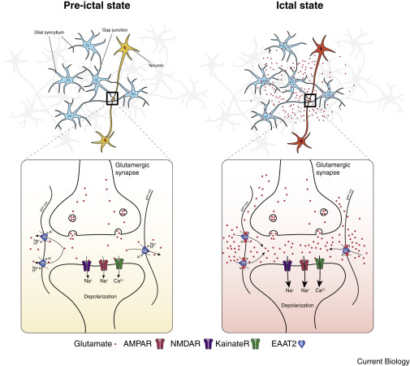

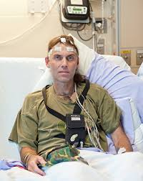
Introduction
5
Epilepsy Prediction and Emergency Response System-(11)

Slide 6
Problem Definition
Epilepsy is a neurological disorder that affects millions of people worldwide, causing unpredictable and debilitating seizures that can lead to injuries, emotional trauma, and even death.
Current methods for managing epilepsy rely on manual observation, medication, and emergency services, which may not always be readily available or effective in preventing severe seizures.
Key Challenges:
1. Timely Detection: Existing methods often fail to detect seizure onset, leading to delayed medical intervention.
2. Inadequate Response: Current emergency responses may not be tailored to individual needs, leading to inadequate care.
3. Increased Risk: Delayed or inadequate treatment can result in increased risk of injury, emotional trauma, and even death.
6
Epilepsy Prediction and Emergency Response System-(11)

Slide 7
Aim and Objectives
Develop a machine that accurately detects epilepsy symptoms in real-time.
Design an automated injection system for rapid administration of calming medication.
Create a user-friendly interface for easy monitoring and alerts.
Target User:
1. Individuals living with epilepsy
2. Caregivers and family members
3. Medical professionals/Hospitals
7
Epilepsy Prediction and Emergency Response System-(11)

Slide 8
Literature Review
Sr. No. | Title of the paper | Author | Year of Publication/ Publisher | Major observations/findings
1 | Machine Learning-Based Early Seizure Detection: A Random Forest Classifier Approach for Pre-Ictal Stage Prediction in Epilepsy | M Anaz Mohammed Vishar; Hepsiba. D; R Prasanna; L. D. Vijay Anand | 2024 ICBSII | It revolutionizes patient monitoring by using wearables to collect and send data to advanced platforms, either in the cloud or locally. singular sensor approach is insufficient due to the diverse manifestations of epilepsy.
2 | EEG-based Epilepsy Seizure Classification Using Explainable Machine Learning Algorithms | Krishna Mridha; MD. Mezbah Uddin; Ebisa Leta Desisa; Asefa Teganu Feyisa; | 2023 ICAECC | This paper introduces the design of an efficient, lightweight, and expressive deep network model based on ResNet theory and long short-term memory (LSTM) for classifying seizure types from EEG trials.
8
Epilepsy Prediction and Emergency Response System-(11)
Notes:
8

Slide 9
Literature Review
Sr. No. | Title of the paper | Author | Year of Publication/ Publisher | Major observations/findings
3 | EEG Driven Autonomous Injection System For An Epileptic Neuroimaging Application | Ronak Doshi, Arvind Ram Sankar, Krishna Nagaraj , Vikas Vazhayil, Chandana Nagaraj , and Madhav Rao | 2021 IEEE | Used SPECT to scan quality with accurate information on foci region. Prediction Model achieved 94% accuracy.
4 | A Framework for Epileptic Seizure Monitoring Based on IoT and Machine Learning Technologies | Alhasan Alharbi, Mukta Dhopeshwarkar, Zeyad A.T.Ahmed, Ezzaldeen Mahyoub, Mohammed Tawfik, Ali Manour Almadani | 2024 IEEE | The Internet of Things (IoT) is a potentially revolutionary development in the medical industry since it makes it possible to collect data from individuals using biosensors
9
Epilepsy Prediction and Emergency Response System-(11)
Notes:
9

Slide 10
Patent Search
Sr. No. | Title of the paper | Author | Year of Publication/ Publisher | Major observations/findings
1 | Device and method for detecting an epileptic event | Uri Kramer,Amos ShahamShai Shpitalnik, Noam Weissman, Yael Goren, Uri Kartoun | Feb. 7, 2012 United States Patent | The invention discloses an epileptic event alert System, capable of detecting and analyzing whether motions sensed by at least one motion sensor of the system, are related to an epileptic seizure event. The system may be utilized for detection of additional motion-related pathologies.
2 | EPILEPTIC SEIZURE WARNING SYSTEM | Sam S. Viglione, Anaheim; Vladimir A. Ordon, Long Beach; William B. Martin, Newport Beach; | Feb. 4, 1975 ICAECC | Epileptic seizure warning system based on pattern recognition principles is embodied in a small self contained device which can be carried in a pocket of a person subject to grand mal seizures, to monitor the person's condition and provide sufficient advance warning
10
Epilepsy Prediction and Emergency Response System-(11)
Notes:
10

Slide 11
Research Gap
Issues
User Experience:
Complexity: The system might be too complex or difficult to use, especially for individuals with limited technical knowledge or cognitive impairments
Cost:
The cost of these machines can be very high not possible to buy by middle class families.
Not Portable:
The current System are heavy and must be placed at hospital
Difficult in finding solid parameter:
Hard to find Symptoms that can be taken as parameter for training model other than EEG
9
Epilepsy Prediction and Emergency Response System-(11)
Notes:
11

Slide 12
Research Gap
Solutions:
Advanced Algorithms:
Employ more sophisticated machine learning algorithms and techniques.
API Integration:
Develop APIs to enable seamless integration with other healthcare systems.
Continuous Learning:
Regularly update the system with new data to improve its performance over time.
Customization:
Allow users to customize the system to their specific needs and preferences.
Cost:
Less Cost
10
Epilepsy Prediction and Emergency Response System-(11)
Notes:
12

Slide 13
Hardware/Software Requirement
1. Seizure detection system:
- Electroencephalography (EEG) or Electrocorticography (ECoG) sensors to monitor brain activity.
F = frontal. Fp = frontopolar. T = temporal. C = central. P = parietal. O = occipital. A = auricular (ear electrode)
- Machine learning algorithms to analyze brain signals and detect seizure patterns.
2. Symptom detection module:
- Sensors to monitor physiological signals like heart rate, blood pressure, and muscle activity.
- Computer vision or motion sensors to detect physical symptoms like convulsions or tremors.
11
Epilepsy Prediction and Emergency Response System-(11)
Notes:
13

Slide 14
Hardware/Software Requirement
3. Alarm system:
- A small, portable Alarm device that can tell the that he might be having an seizure.
4. Power supply and electronics:
- A compact, wearable, or portable power source (e.g., battery).
- Electronic circuits to control the sensors, algorithms system.
5. Software and programming:
- Develop algorithms to integrate data from various sensors and detect seizure symptoms.
- Program the system to trigger the Alarm when a seizure is detected.
12
Epilepsy Prediction and Emergency Response System-(11)
Notes:
14

Slide 15
Proposed methodology
Data Acquisition
Gathering historical data on past epilepsy patient. This data include information as EEG readings and outcomes (Epileptic or not Epileptic).
Feature Scaling
Standardize or normalize data to ensure all features are on a consistent scale Training the selected machine learning model(s) on the training data.
Machine Learning Model Development
We have used Linear Regression, Support Vector Regression, Decision Tree ,Random Forest Regressor, and Gradient Boosting Regressor , K-Neighbor, Logistic Regressor based on dataset characteristics and project requirements for Regression method.
13
Epilepsy Prediction and Emergency Response System-(11)
Notes:
15

Slide 16
Proposed methodology
Model Evaluation and Refinement
Regularly update the system with new data to improve its performance over time.
Alarm System
Integration with Emergency Response Systems
13
Epilepsy Prediction and Emergency Response System-(11)
Notes:
16

Slide 17
Experimental Research
To develop a machine learning-based system capable of accurately predicting impending epileptic seizures from real-time EEG data.
To evaluate the effectiveness of the system in triggering timely alarms to alert caregivers or emergency services.
To assess the system's impact on the quality of life for individuals with epilepsy.
14
Epilepsy Prediction and Emergency Response System-(11)
Notes:
17

Slide 18
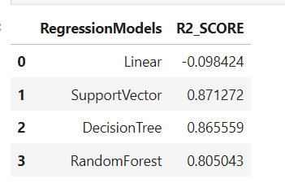
Experimental Research
14
Epilepsy Prediction and Emergency Response System-(11)
Notes:
18

Slide 19
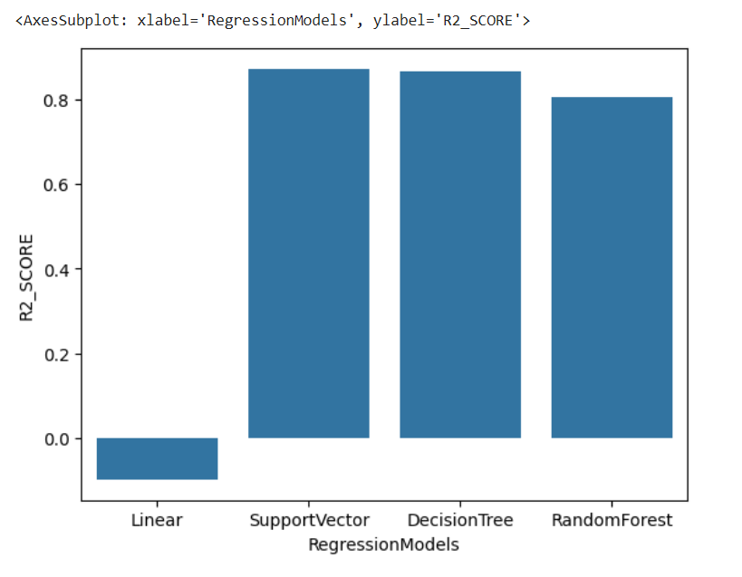
Experimental Research
13
Epilepsy Prediction and Emergency Response System-(11)
Notes:
19

Slide 20
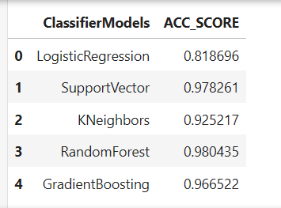
Experimental Research
13
Epilepsy Prediction and Emergency Response System-(11)
Notes:
20

Slide 21
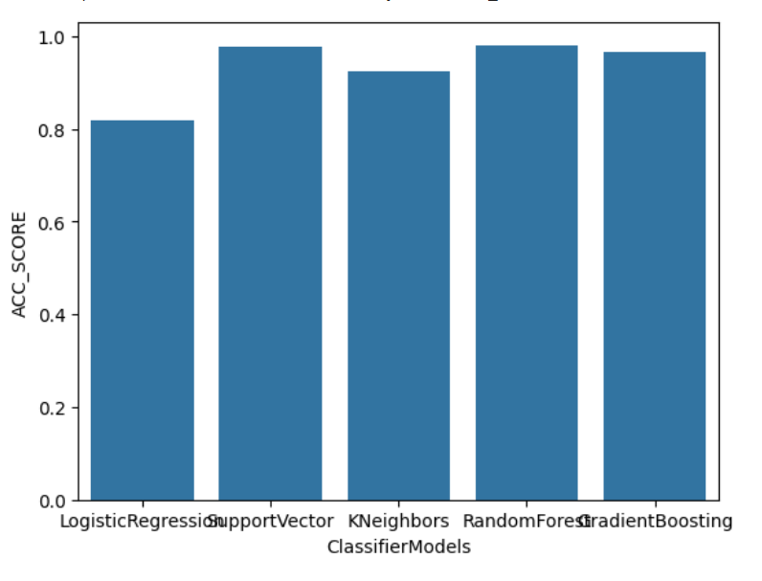
Experimental Research
13
Epilepsy Prediction and Emergency Response System-(11)
Notes:
21

Slide 22
Plan of Action
Activity (2024) | July-Aug | Aug-Sept | Sept-Oct | Oct-Nov | Nov-Dec
Literature Survey
Analysis of literature data
Study of data
Creating Machine Learning Model
Connecting to Machine and Applying Response system
Conclusions
Preparation of Project Report/Paper Writing
Notes:
22

Slide 23
Conclusion and Future Scope
This Machine Learning model uses Regression as well as Classification Algorithms.
After Getting their Score we chose the highest scored algorithm which was Random Forest Classifier Algorithm.
In the next Module, We will be creating Alert System that will be taking input from EEG machine and that system will continuously read from the patient.
Mobile App Integration : Develop mobile app for easy access and management of the system.
Personalized Response Plans: Allow users to create personalized emergency response plans, including contact information, medical history, and preferred treatment options.
Remote Consultation: Enable remote consultations with healthcare providers for timely advice and treatment.
16
Epilepsy Prediction and Emergency Response System-(11)
Notes:
23

Slide 24
References
R. Doshi, A. R. Sankar, K. Nagaraj, V. Vazhayil, C. Nagaraj and M. Rao, "EEG Driven Autonomous Injection System For An Epileptic Neuroimaging Application," 2021 43rd Annual International Conference of the IEEE Engineering in Medicine & Biology Society (EMBC), Mexico, 2021, pp. 1480-1486, doi: 10.1109/EMBC46164.2021.9629573. keywords: {Neuroimaging;Hospitals;Computational modeling;Surgery;Predictive models;Tools;Brain modeling},
A. Alharbi, M. Dhopeshwarkar, Z. A. T. Ahmed, E. Mahyoub, M. Tawfik and A. M. Almadani, "A Framework for Epileptic Seizure Monitoring Based on IoT and Machine Learning Technologies," 2024 3rd International Conference for Innovation in Technology (INOCON), Bangalore, India, 2024, pp. 1-8, doi: 10.1109/INOCON60754.2024.10512226. keywords: {Patient monitoring;Cloud computing;Technological innovation;Epilepsy;Medical services;Software;Internet of Things;Epilepsy;IoT;Healthcare;Cloud Computing;Classification;H-IoT;Remote Monitoring},
17
Epilepsy Prediction and Emergency Response System-(11)
Notes:
24

Slide 25
References
I. Bhattacherjee, "A Comparative Analysis of Machine Learning Techniques for Epileptic Seizure Detection and Classification," 2022 9th International Conference on Computing for Sustainable Global Development (INDIACom), New Delhi, India, 2022, pp. 310-317, doi: 10.23919/INDIACom54597.2022.9763288. keywords: {Support vector machines;Wearable computers;Machine learning;Activity recognition;Feature extraction;Electroencephalography;Real-time systems;Epileptic seizure detection;classification of seizure activities;machine learning techniques;human activity recognition method;fine KNN;weighted KNN;fine Gaussian SVM},
M. Umme salma and Najmusseher, "Classification Algorithms Used In The Study of EEG-Based Epileptic Seizure Detection," 2021 2nd International Conference on Smart Electronics and Communication (ICOSEC), Trichy, India, 2021, pp. 1518-1521, doi: 10.1109/ICOSEC51865.2021.9591824. keywords: {Sociology;Epilepsy;Support vector machine classification;Electroencephalography;Classification algorithms;Naive Bayes methods;Statistics;EEG;Epileptic Seizures;Classification;SVM;XGBOOST;Linear Discriminant Analysis;kNN;Decision Tree Classifier},
18
Epilepsy Prediction and Emergency Response System-(11)
Notes:
25

Slide 26
Thank You…….
19
Epilepsy Prediction and Emergency Response System-(11)

